Slide 1

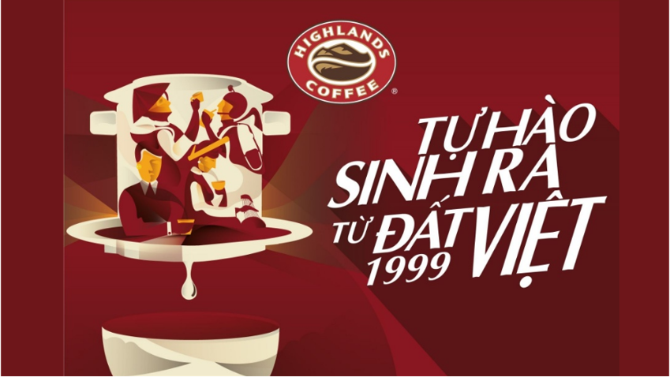

Slide 2
Final Report
Group 3

Slide 3

Final Report
Group 3
Task 1
Task 2
Task 3
Task 4

Slide 4
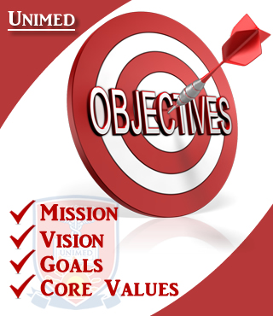
1
About The Organization

Slide 5

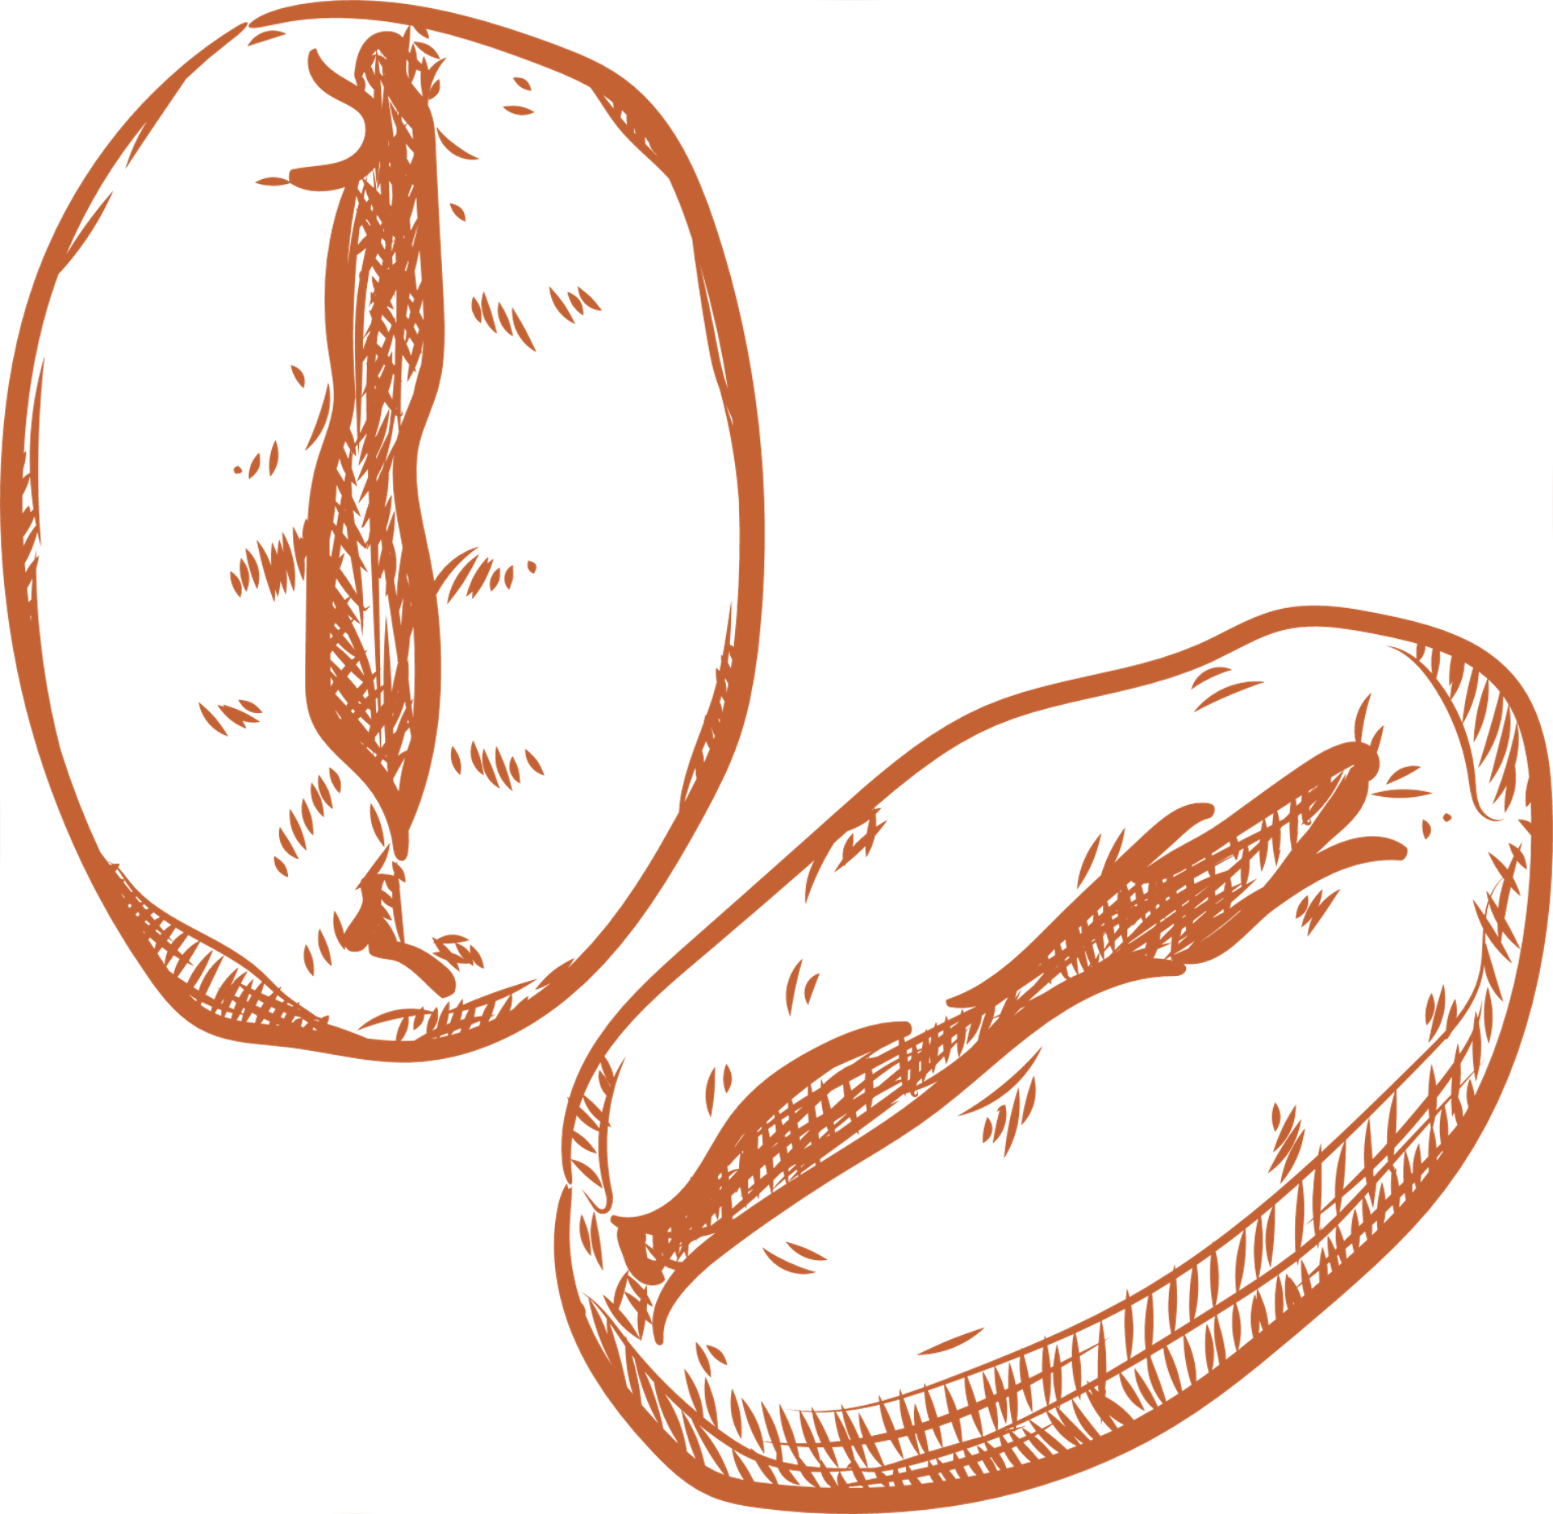
Objectives and Mission
Objectives
1
To be leading coffee chain in terms of quality, customer experience and innovation.
2
To be expand the number of outlet domestically and internationally.
2
1
3
To promote sustainable an ethical sourcing of coffee beans.

Slide 6
Objectives and Mission
Mission
Highlands Coffee is committed to delivering exceptional coffee experiences, fostering community connections, and driving sustainability in every cup.
!
2

Slide 7

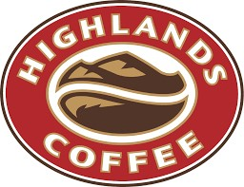
History and Industry
History
<

Slide 8
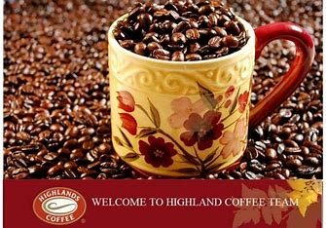
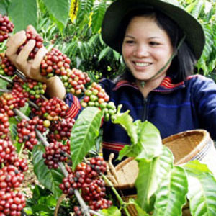
History and Industry
Industry

Slide 9
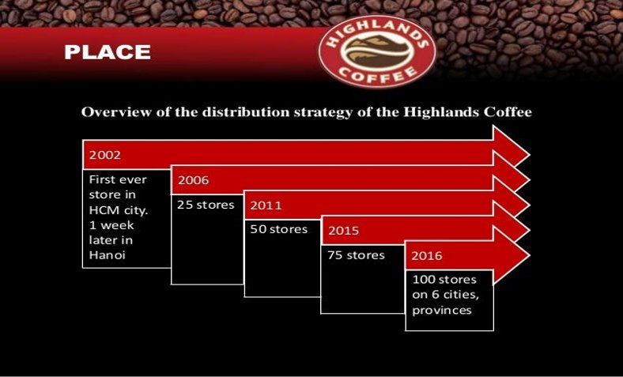
Size and organization chart
Size

Slide 10
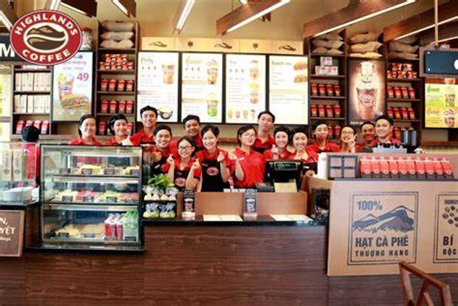
Size and organization chart
Organization chart

Slide 11
Business Area/Function
Main Business Area:
1
Coffee and Beverage Sales
2
Customer Experience
2
1
3
Sustainability an Sourcing

Slide 12
Business Area/Function
Function Alignment:
1
Sales efforts align with the objective
2
Customer Experience
2
1
3
Sustainability an Sourcing

Slide 13
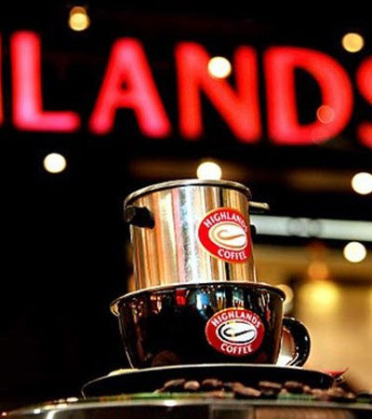
2
Analyze Your Existing Information System

Slide 14

Analyze Existing Information System
* Analyzing Industry Structure and Target Market Share
* Competitive strategy and the development of Highlands from the present to the next 10 years
* Main Activities in Value Chain
* The Five Key Components

Slide 15
Industry Structure
Target Market
1
Data-Driven Expansion: Using market data, Highlands Coffee has targeted expansion in areas with less market saturation and high potential customer base.
2
Diversification: Diversifying their product offerings to cater to a broader range of tastes and preferences helps capture a larger market share.
2
1
3
Digital Engagement: Leveraging digital platforms for marketing and customer engagement also aids in expanding their reach, especially among younger, tech-savvy consumers.

Slide 16

Threat of New Entrants
3
2

Slide 17

Bargaining Power of Suppliers
3
2

Slide 18

Bargaining Power of Buyers
3
2

Slide 19
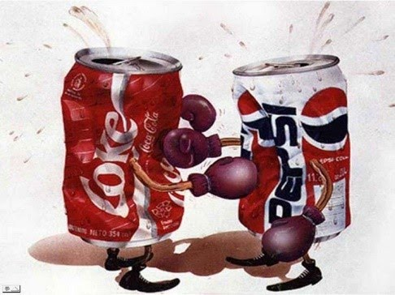
Threat of Substitute Products
3
2

Slide 20

Competitive Rivalry:
3
2

Slide 21
Industry Structure
Target Market
1
Data-Driven Expansion: Using market data, Highlands Coffee has targeted expansion in areas with less market saturation and high potential customer base.
2
Diversification: Diversifying their product offerings to cater to a broader range of tastes and preferences helps capture a larger market share.
2
1
3
Digital Engagement: Leveraging digital platforms for marketing and customer engagement also aids in expanding their reach, especially among younger, tech-savvy consumers.

Slide 22
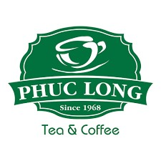
Competitive strategy present
FOCUS STRATEGY
<

Slide 23
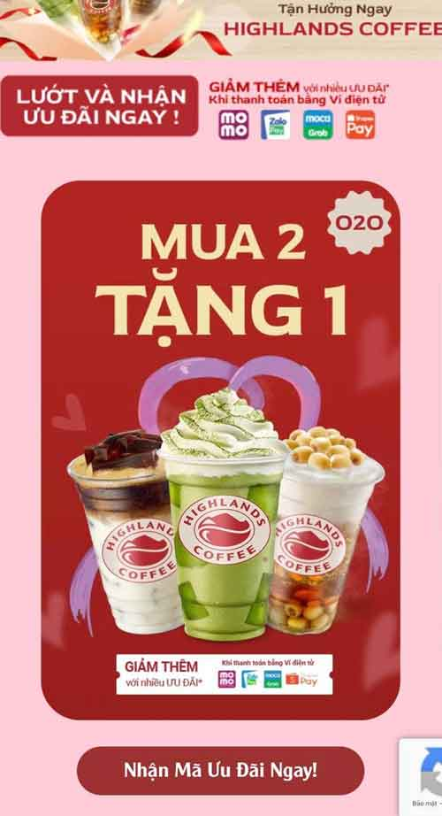
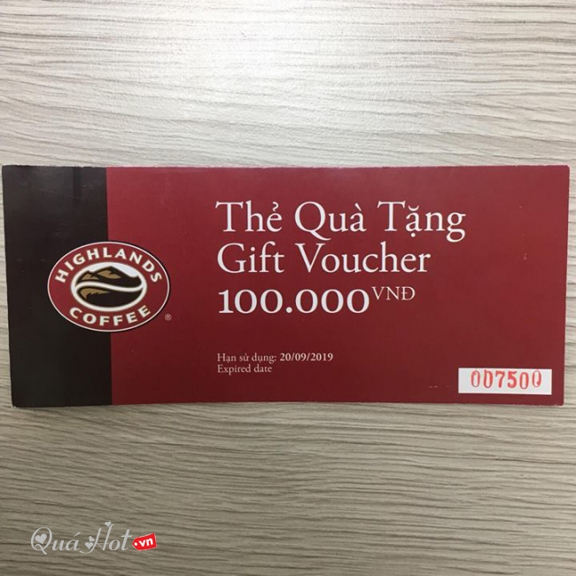
Competitive strategy present
FOCUS ➔ COST LEADERSHIP

Slide 24
COST LEADERSHIP
ADVANTAGES
1
Market Competitiveness: In a price-sensitive market, being a cost leader provides a strong competitive advantage.
2
Broad Market Appeal:Lower prices attract a diverse customer base, expanding market reach.
2
1
3
Resilience to Market Fluctuations: This strategy offers resilience against economic downturns, as customers seek more affordable options.

Slide 25
COST LEADERSHIP
DISADVANTAGES
1
Profit Margin Pressure: Maintaining low prices can exert pressure on profit margins.
2
Risk of Quality Perception: There's a potential risk that customers might perceive lower prices as indicative of lower quality
2
1
3
Competitive Imitation: Competitors might emulate the cost leadership strategy, leading to intensified price competition.

Slide 26
COST LEADERSHIP
Relationship with Industry Structure:
In the highly competitive coffee industry, cost leadership allows Highlands Coffee to stand out in a saturated market. It aligns with the need to capture a significant market share in an environment where price and value are key determinants of consumer choice.
2
1
3

Slide 27


Competitive strategy next 10 years
BALANCE FOCUS + COST LEADERSHIP
Wider Market Appeal:
Combining cost leadership with focused offerings allows Highlands Coffee to appeal to both price-sensitive customers and niche markets that value specialty products or experiences.
Flexibility and Adaptability:
By not relying solely on either cost leadership or a focus approach, Highlands Coffee can remain agile and adaptable to market changes and varying consumer preferences.
2
2

Slide 28
Competitive strategy next 10 years
BALANCE FOCUS + COST LEADERSHIP
3
Enhanced Customer Loyalty:
Through focused elements, particularly in customer experience and specialty offerings, Highlands Coffee can cultivate deeper brand loyalty among specific customer segments.
Increased Revenue Opportunities:
The Focus strategy elements can tap into higher-margin niches, complementing the broader revenue generated from the cost leadership approach.
4

Slide 29
Value Chain
1
Inbound Logistics: This stage is critical for ensuring product quality and consistency across all outlets. Ethical and sustainable sourcing practices also reinforce the brand's commitment to environmental responsibility.
2
Marketing and Sales: Strong marketing and sales efforts are essential for building brand awareness and attracting new customers. Engaging existing customers through loyalty programs and promotions is crucial for long-term revenue growth.
2

Slide 30
Value Chain
3
Service: Exceptional service leads to customer satisfaction and loyalty, which are essential for the brand’s reputation and word-of-mouth marketing. Consistently excellent service across all outlets fosters a strong, loyal customer base.
2

Slide 31

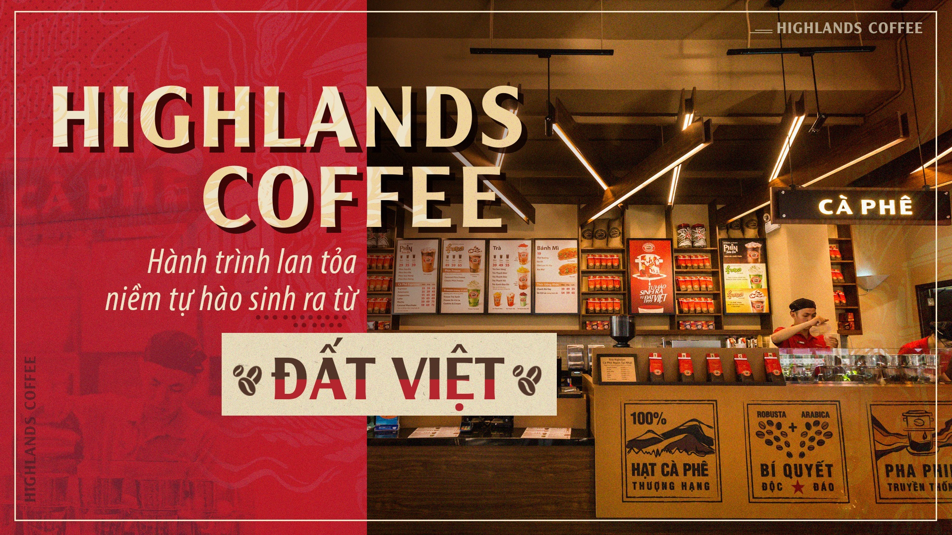
The Five Key Components
1
1
2
3
4
5
Process
Hardware
Software
People
Data

Slide 32
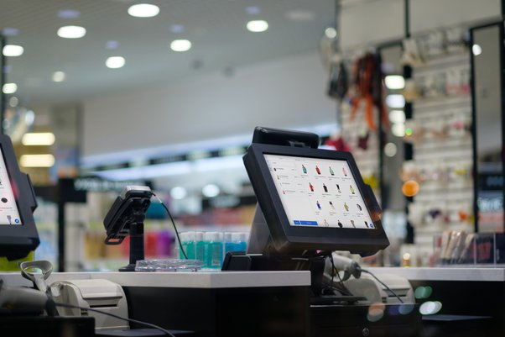
HARDWARE
3
2

Slide 33
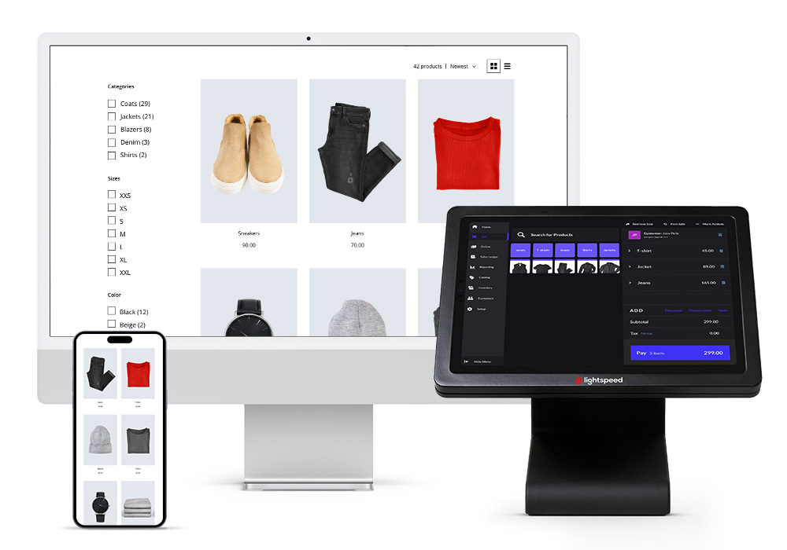
SOFTWARE
3
2

Slide 34

PEOPLE
3
2

Slide 35
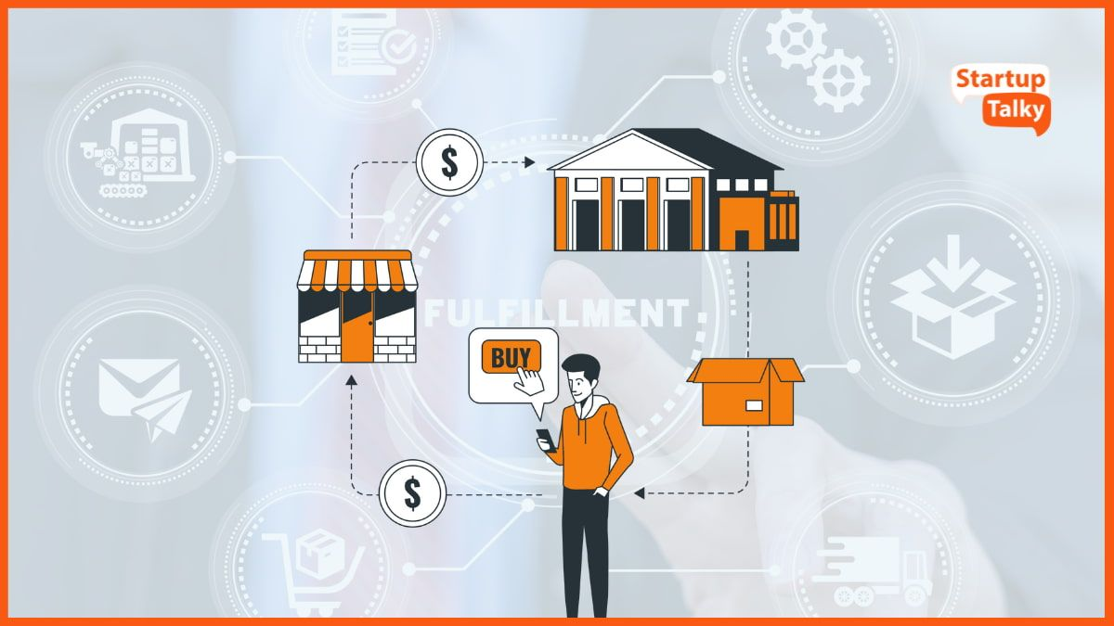
PROCESS
3
2

Slide 36
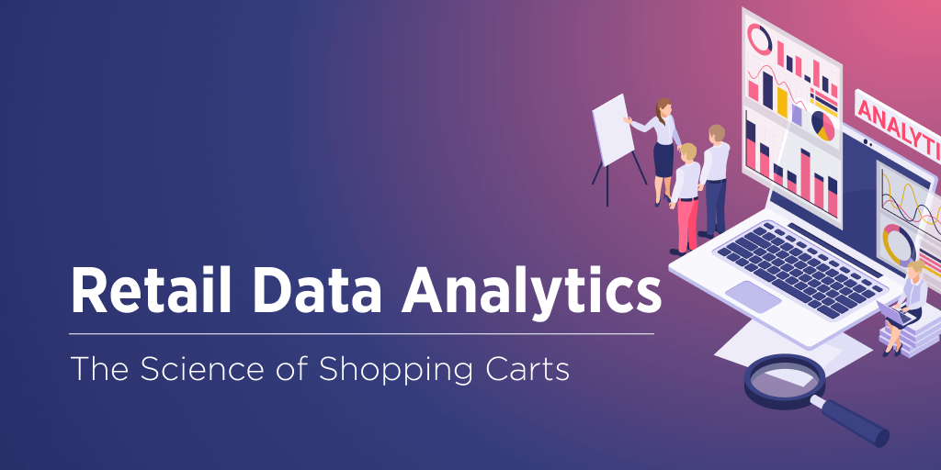
DATA
3
2

Slide 37
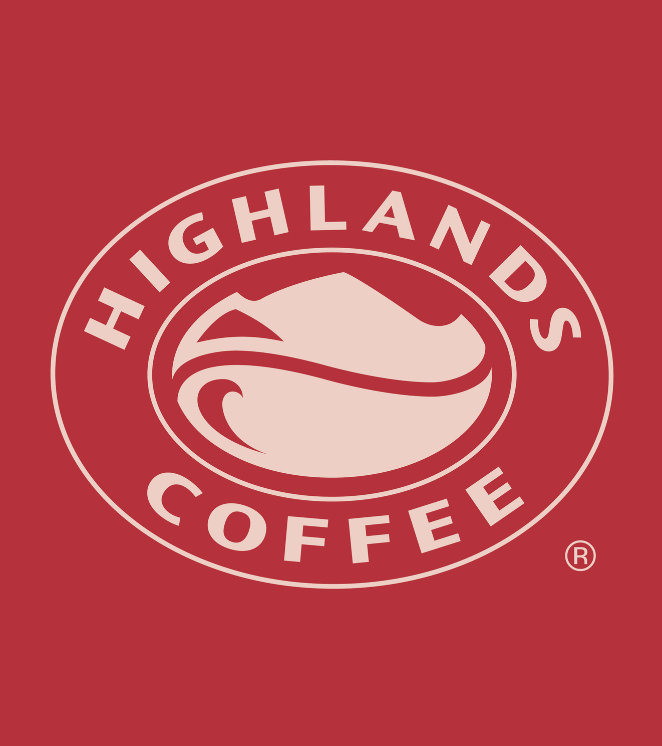
3
Organizational issues

Slide 38
Organizational issues
The existing problems of the old system and the expected goals of the new system
Analysis of Problem Components/Structures

Slide 39
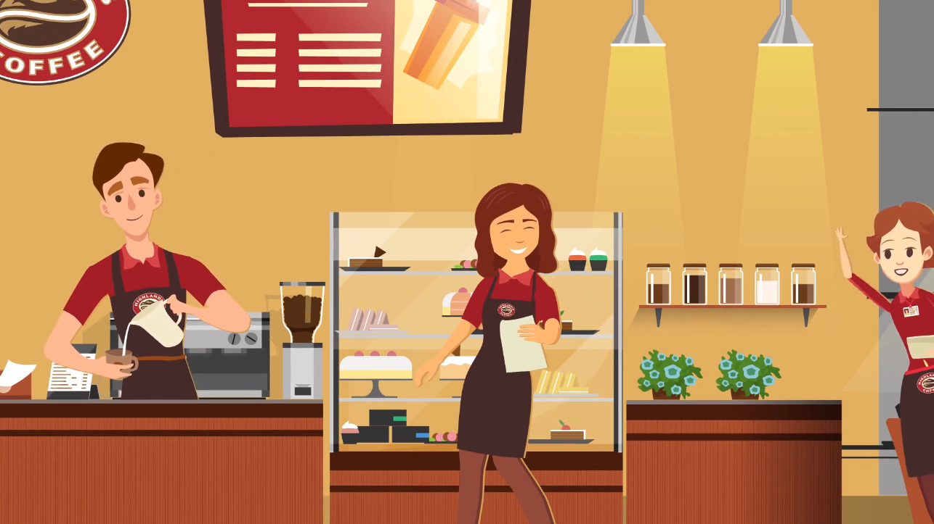
The existing problems of the old system and the expected goals of the new system

Slide 40
The existing problems of the old system and the expected goals of the new system
1
The existing problems
•Operational Complexity: Managing two strategic approaches simultaneously can lead to increased complexity in operations, supply chain management, and marketing efforts.
•Risk of Brand Dilution: There is a risk that the brand’s identity may become diluted or inconsistent if the balance between cost leadership and focused offerings is not carefully managed..
2
•Potential Internal Conflicts: Aligning corporate culture, employee training, and operational processes with a dual strategy might present internal alignment challenges.
•Customer reviews: Unfamiliar with the services and drink names, the process is sometimes slow, leading to customers waiting for a long time

Slide 41
The existing problems of the old system and the expected goals of the new system
1
The existing problems
•Staff problems: Difficult to synchronize and manage training quality, Highlands' training content cannot be standardized and synchronized between branches.
•Increased Resource Allocation: Implementing and maintaining a Focus strategy alongside cost leadership may require additional resources, particularly in areas like R&D, marketing, and customer service.
2
•Balancing Price Perception and Quality: Maintaining the perception of quality in the cost leadership segment while justifying premium pricing in the focus segment can be challenging.

Slide 42
The existing problems of the old system and the expected goals of the new system
2
The expected goals
•Reduce operational complexity: Appropriate division of human resources to reduce operational and supply chain complexity.
•Manage and synchronize training quality and employee capacity through system: Upgrade the system to manage each employee's learning process as well as update new knowledge and formulas to send to all branches nationwide.
2
•Scalability and Flexibility: It seeks to be scalable, adaptable to changing business needs, and flexible enough to accommodate future growth.
•Enhanced Integration: Foster seamless integration between different departments and systems to improve overall organizational efficiency.

Slide 43
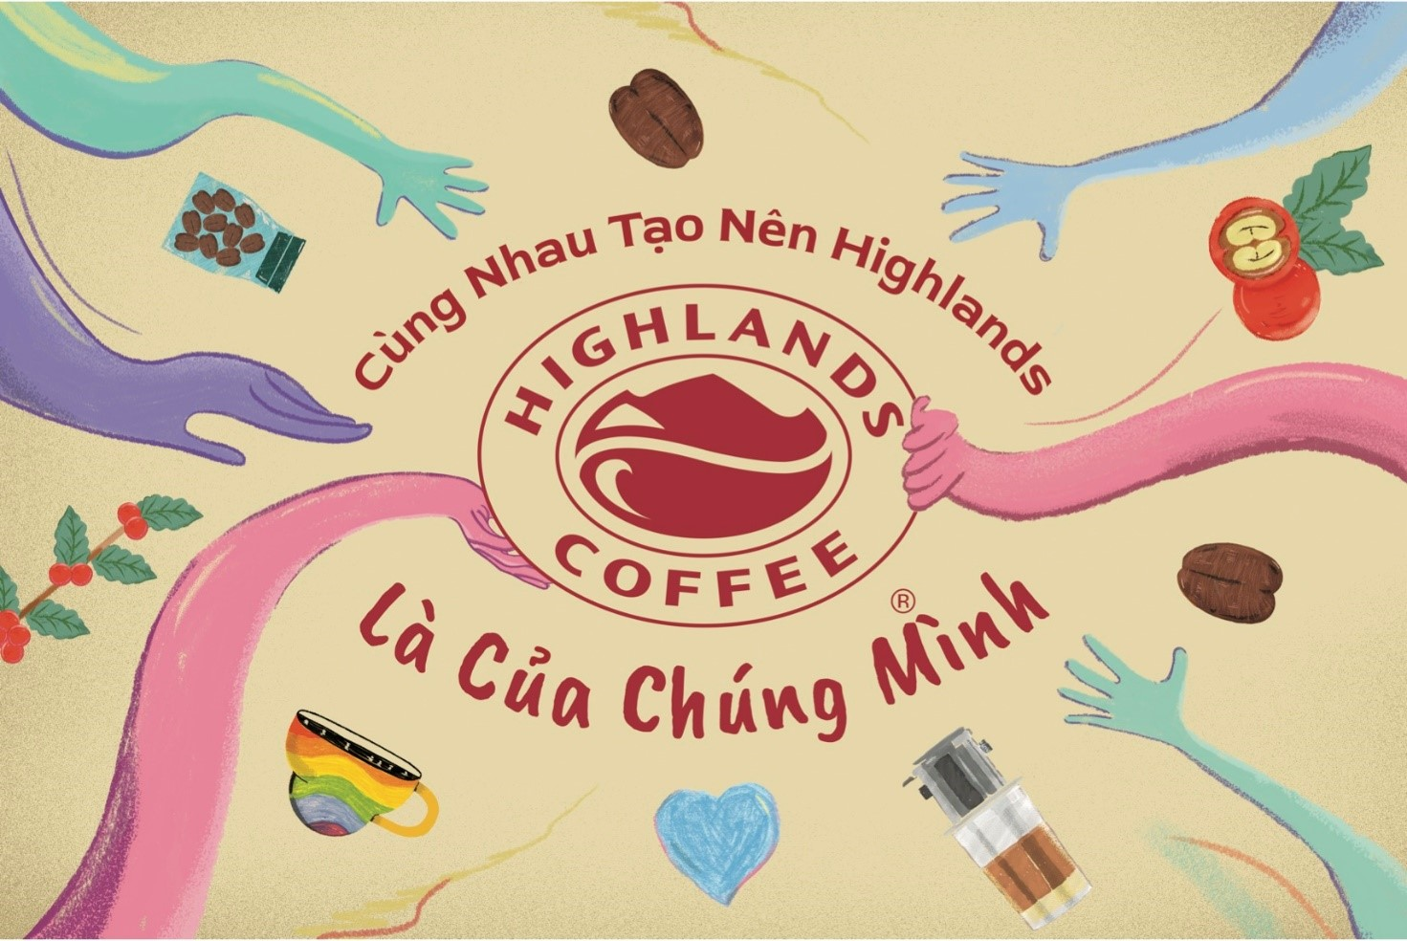
Analysis of Problem Components/Structures

Slide 44
Analysis of Problem Components/Structures
1
2
3
4
Process
Hardware
Software
People

Slide 45
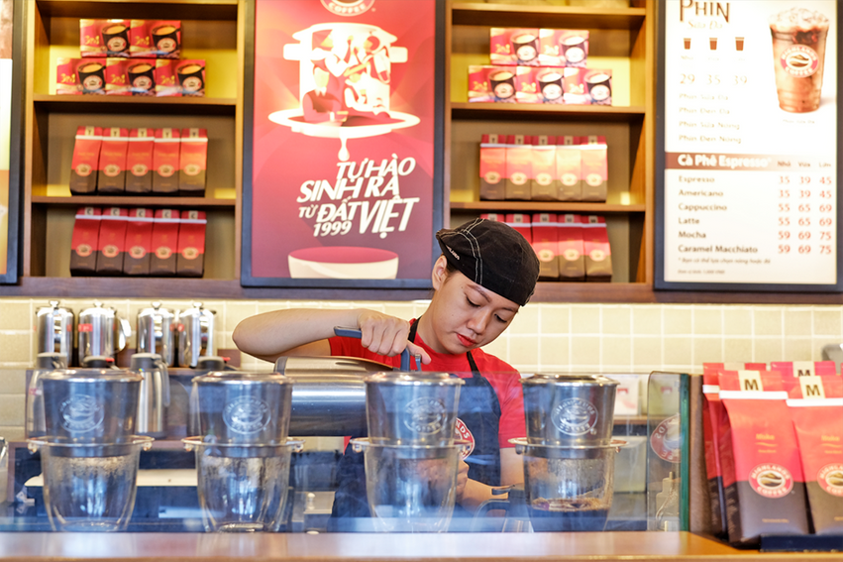
Analysis of Problem Components/Structures
1. Process
•Order processing: Problems with the order processing process, slow responses, or inadequate problem resolution, can impact customer satisfaction and retention.
•Data Analysis: If the data within the system is inaccurate or incomplete, Processes that analyze sales, inventory, and customer data make false business decisions.

Slide 46
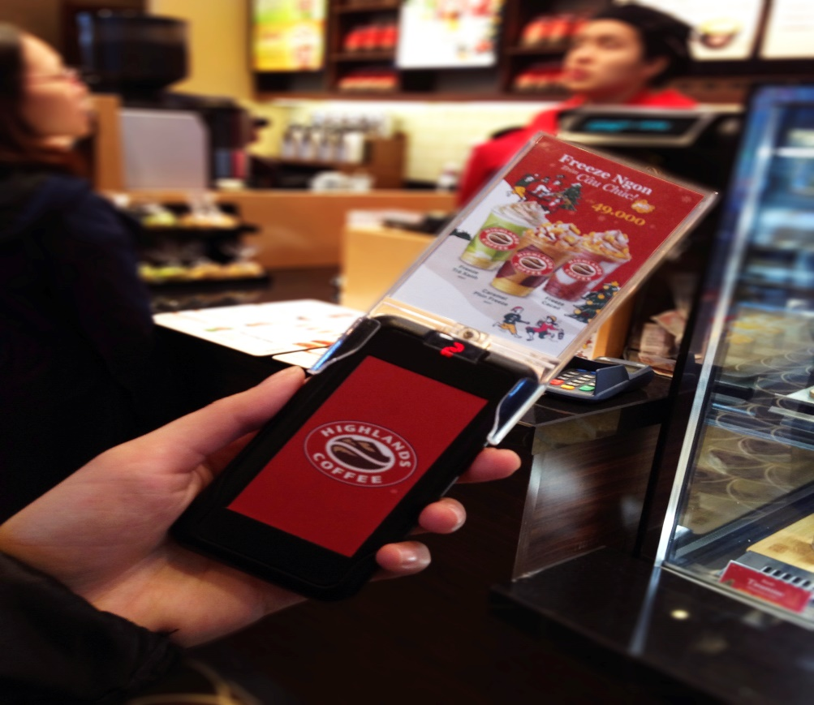
Analysis of Problem Components/Structures
2. Hardware
•Mobile Devices: Need to train a course for employees to use. If customers do not know how to use it, it will take more time and human resources to support.
•Devices Quality: If the equipment does not ensure quality, it can affect the system's ability to sell and develop.

Slide 47

Analysis of Problem Components/Structures
3. Software
•Customer Relationship Management (CRM) Software: If an error occurs, it will lead to loss of customer information and incorrect information processing.
•Software version: Always update to the latest version promptly to avoid incompatible and outdated software.

Slide 48
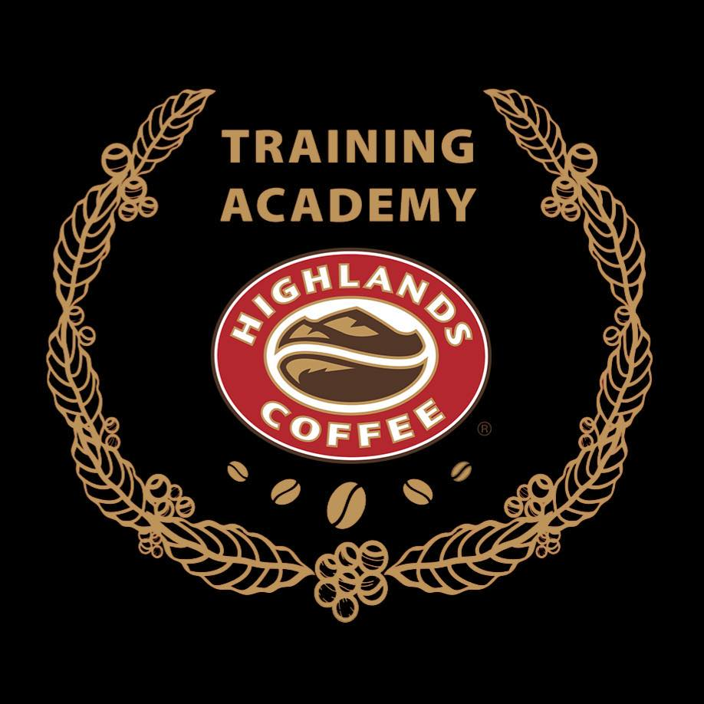
Analysis of Problem Components/Structures
4. People
•Staff Training: Staff between branches have not been trained consistently.
•IT Team: If not guaranteed, it can lead to failure of the entire company system

Slide 49
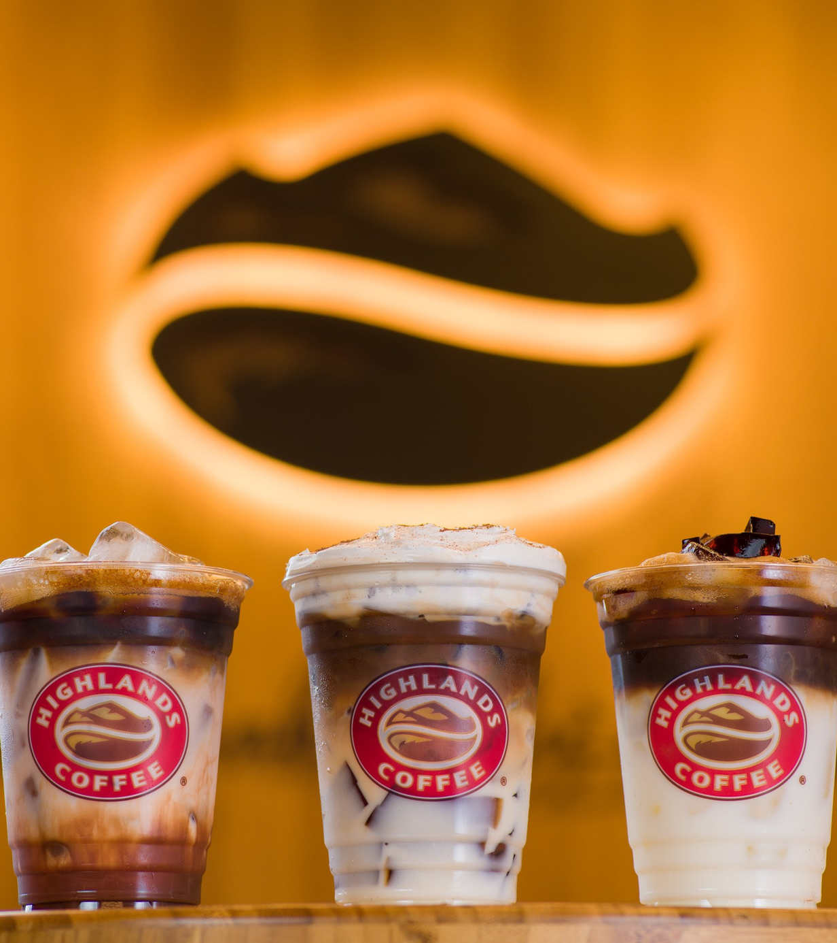
4
AN OVERVIEW
Proposal for a new system

Slide 50
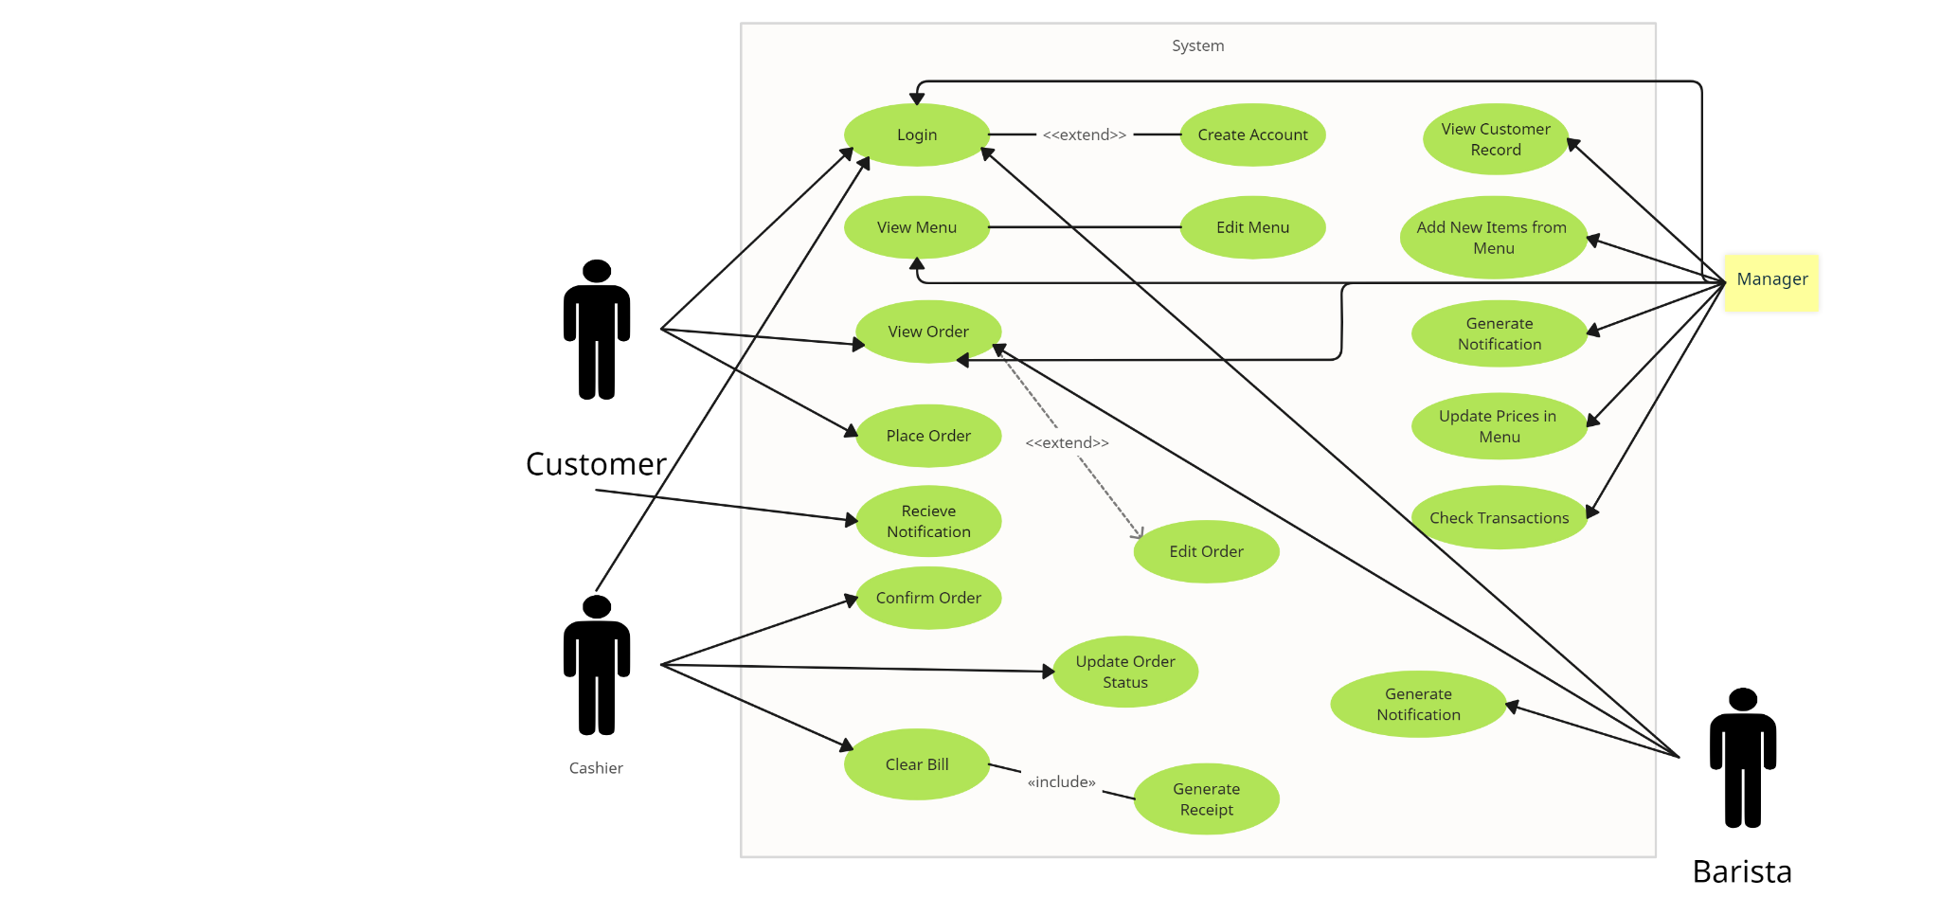
Proposal for a new system
General Use Case Diagram

Slide 51
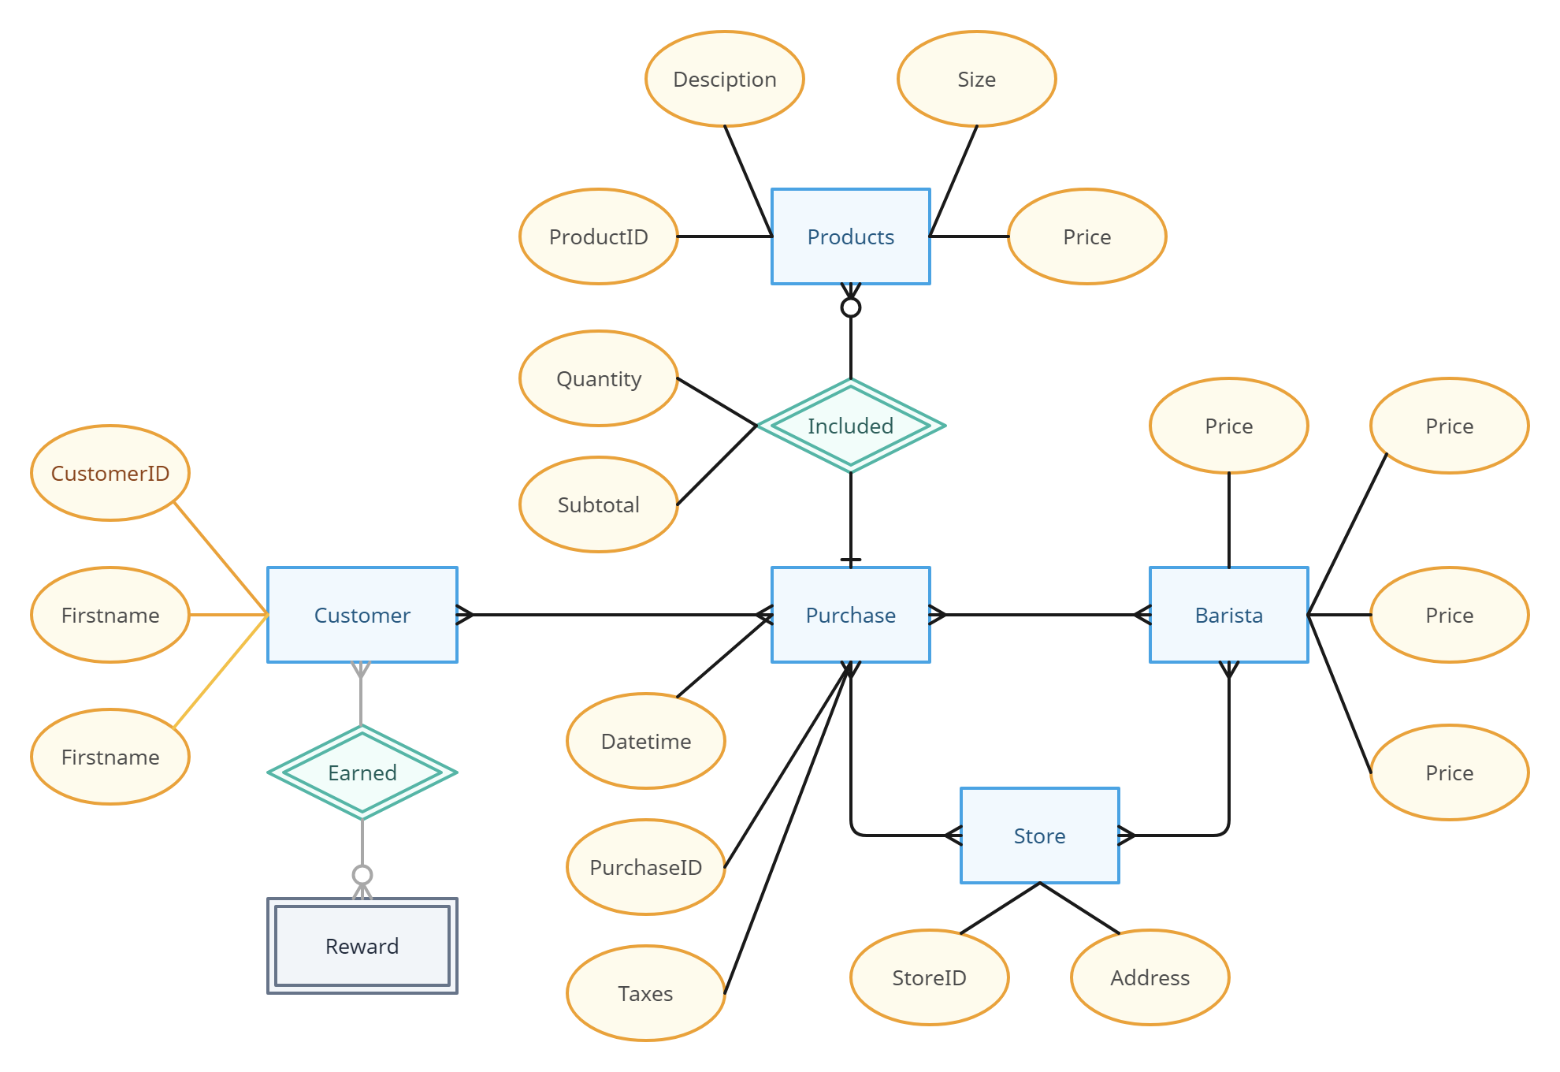
Proposal for a new system
General Use Case Diagram

Slide 52
Proposal for a new system
Changed or Improved Processes
The new system will streamline inventory tracking, automate reordering processes, and provide real-time sales data for each store
Employee scheduling will be optimized based on sales data, and CRM tools will enable targeted marketing and loyalty programs
-

Slide 53
Proposal for a new system
Analysis and Evaluation
The proposed system supports the organization's competitive strategy by enhancing operational efficiency, improving customer experience, and enabling data-driven decision-making
The centralized data will allow for better strategic decision-making at both store and regional levels, leading to improved resource allocation, inventory management, and enhanced customer satisfaction
-

Slide 54
Proposal for a new system
Analysis and Evaluation
Infrastructure upgrades would be required to implement the new MIS, along with extensive employee training to ensure effective adoption. The integration of real-time data and analytics will empower the coffee chain to make informed decisions, optimize supply chain management, and personalize customer interactions
Furthermore, the improved inventory management will reduce stockouts, minimize waste, and enhance overall operational efficiency. This heightened efficiency will contribute to cost savings and could potentially be redirected toward enhancing product offerings or expanding the chain's reach
-

Slide 55
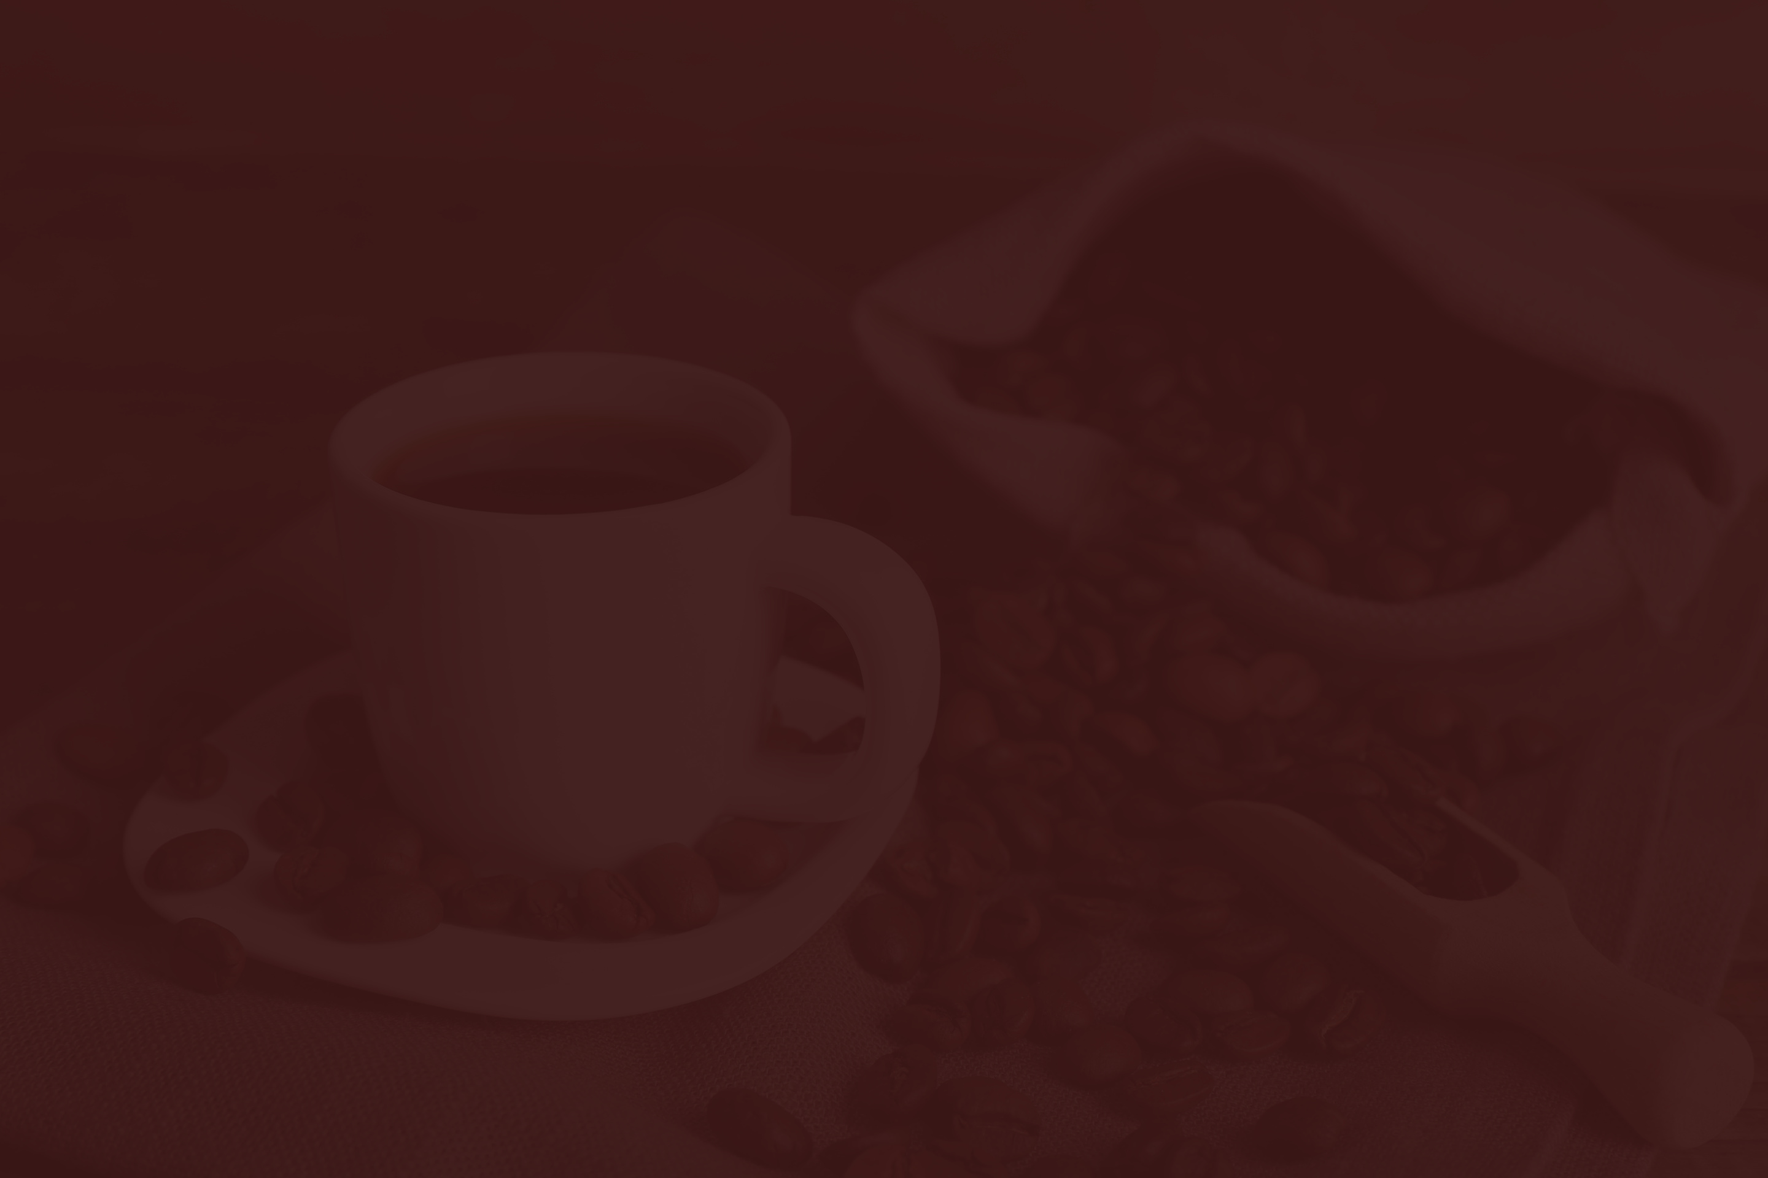

LIVE
DEMO ODOO

